Slide 1


Project Overview
This project aims to analyze the relationship between mortgage attributes to climate risks
Mortgage Climate Risk Report
Corporate Sponsor: Freddie Mac
Faculty Advisor: Professor Clifford Rossi
Mar 2023

Slide 2











Meet the Team
Kanglong Li
Jiaxin Liu
Jiahao Zhang
Lin Zheng
Mengxin Xie
Fengyu Yuan
Yongkang Zheng
Haoruo Yang
Ning Xu
Siddhesh Gore
Qiuyu Xue

Slide 3
Project Agenda
1
Overview and Roadmap
Pg 4
2
Data Gathering and Manipulation
Pg 8
3
Data Visualization
Pg 12
4
Model Building and Validation
Pg 28
5
Appendix
Pg 52

Slide 4
Overview and Roadmap
1
2.8
0.7
1.1
2.9
1.1
0.9
1.0
0.7
0.5
1.5
0.6
0.8
0.8
0.9
1.0
1.2
1.3
1.6
2.0
1.8
1.6

Slide 5

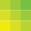
Why Climate Risk?
Rising Topic: Climate Change continues to be at the top of the global agenda, and the risks associated with natural hazards should not be overlooked.
Regulatory Changes: Regulators are reacting to climate risks by increasing their expectations of financial institutions through more information disclosure and impact assessments.
Lack of Studies: Fewer studies have been done on climate risks compared to other risks

Slide 6
Our Goals
With the effects of climate change becoming increasingly pronounced, it is important not to overlook the effects of climate risk poses on the mortgage market. More importantly, are there predictability characteristics in loan applications that can differentiate between low and high climate risk loans.
Data
Visualization
Prediction
Inference
Obtain useful data related to climate risk on the mortgage market
Provide visualization of climate risk characteristics across the U.S.
Accurately predict climate risk exposure based on loan attributes
Interpret relationship of loan attributes on climate risk, can be used for business decisions

Slide 7
Results
Data
Finalized over 13 million useable mortgage data on climate risk, and used 1 million observations for data analysis
Adverse Selection
Freddie Mac is not subject to any adverse selection exposed to climate risk while purchasing mortgages
Racial Inequality
No particular race or ethnicity is exposed to more climate risk
Protected Veteran
VA Loans have a statistically significant lower odds of being in a high climate risk area
Pinpoint Predictions
The loan TRACT-Level variables have strong predictive power on climate risks, can predict with over 99% accuracy

Slide 8
Data Gathering and Data Manipulation
Data is the most important foundation of any analysis, a skewed data set would lead to inaccuracy in predictions and inferences
2
2.8
0.7
1.1
2.9
1.1
0.9
1.0
0.7
0.5
1.5
0.6
0.8
0.8
0.9
1.0
1.2
1.3
1.6
2.0
1.8
1.6

Slide 9


Data Gathering
Loan Application Data: Obtained over 26 million 2021 loan applications data from the FFIEC HMDA website.
Risk Index: Obtained over 70 thousand 2021 tract-level risk indices from the FEMA NRI website.
Geographical Shapefile: Obtained over 70 thousand 2021 tract-level Shapefile from the FEMA NRI website.

Slide 10

Data Cleaning and Manipulation
Setting Constraints: Only kept the data that is first lien and single family
Missing Data: Deleting observations where important attributes are missing.
Standardize Units/Range: Manipulate the attributes of different variables to make them consistent and useable for analysis.
Outliers: First Winsorized then trimmed the data that lies above the 99th or below the 1st percentile.
Merging Data: Mapped the NRI data to the cleaned HMDA data, each application is matched to its respective census tract.
Dummy Variables: Created dummy variables for key borrower’s attributes
Selecting Data: Randomly selected 1 million observations to use for data analysis.

Slide 11
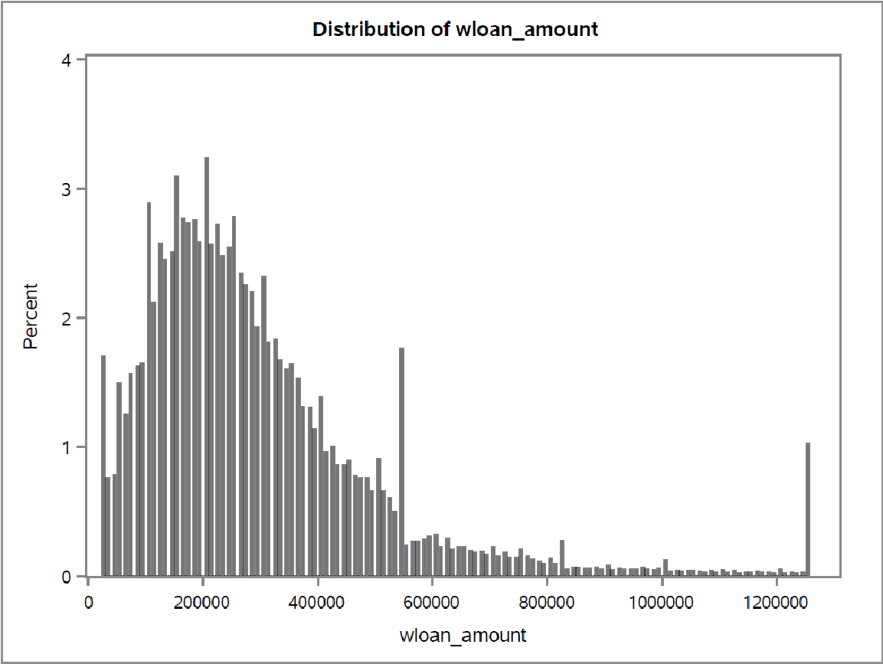
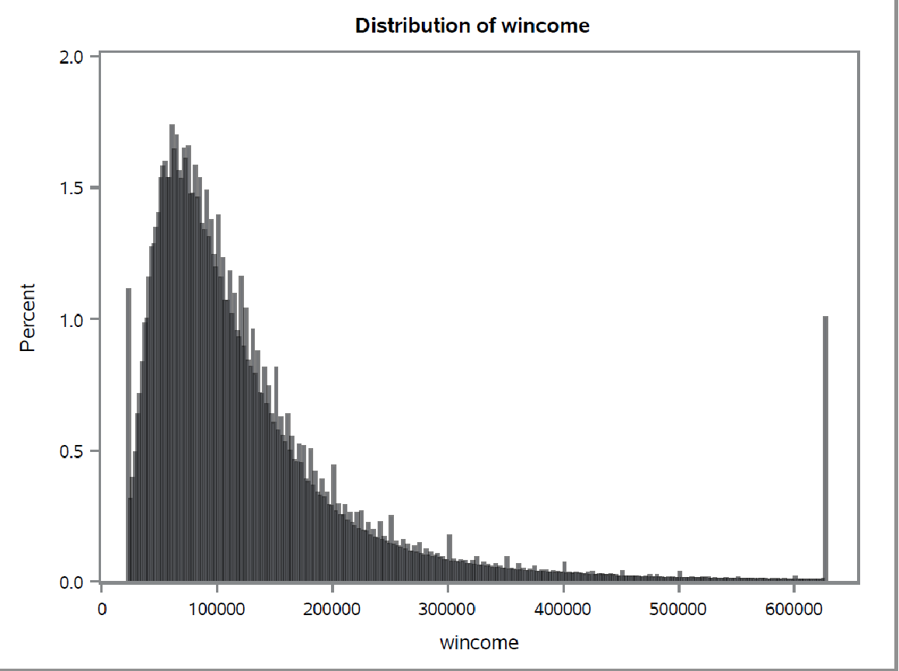
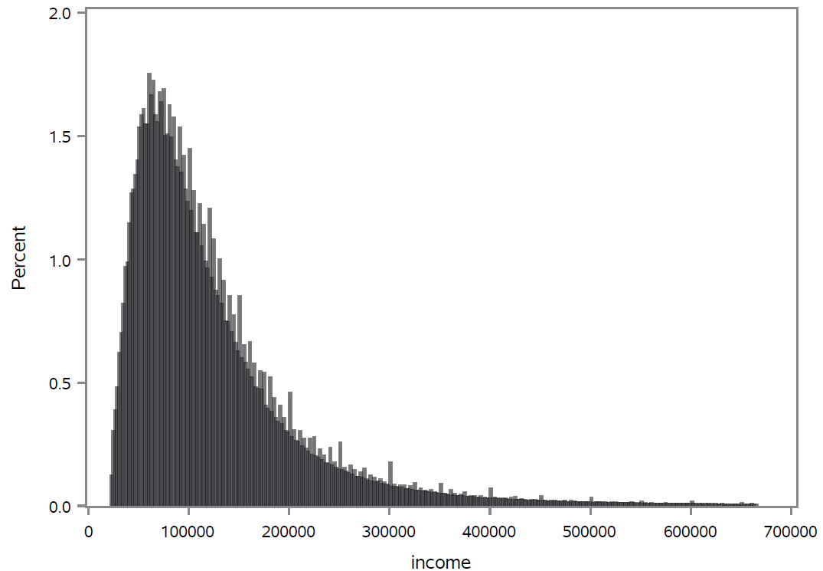
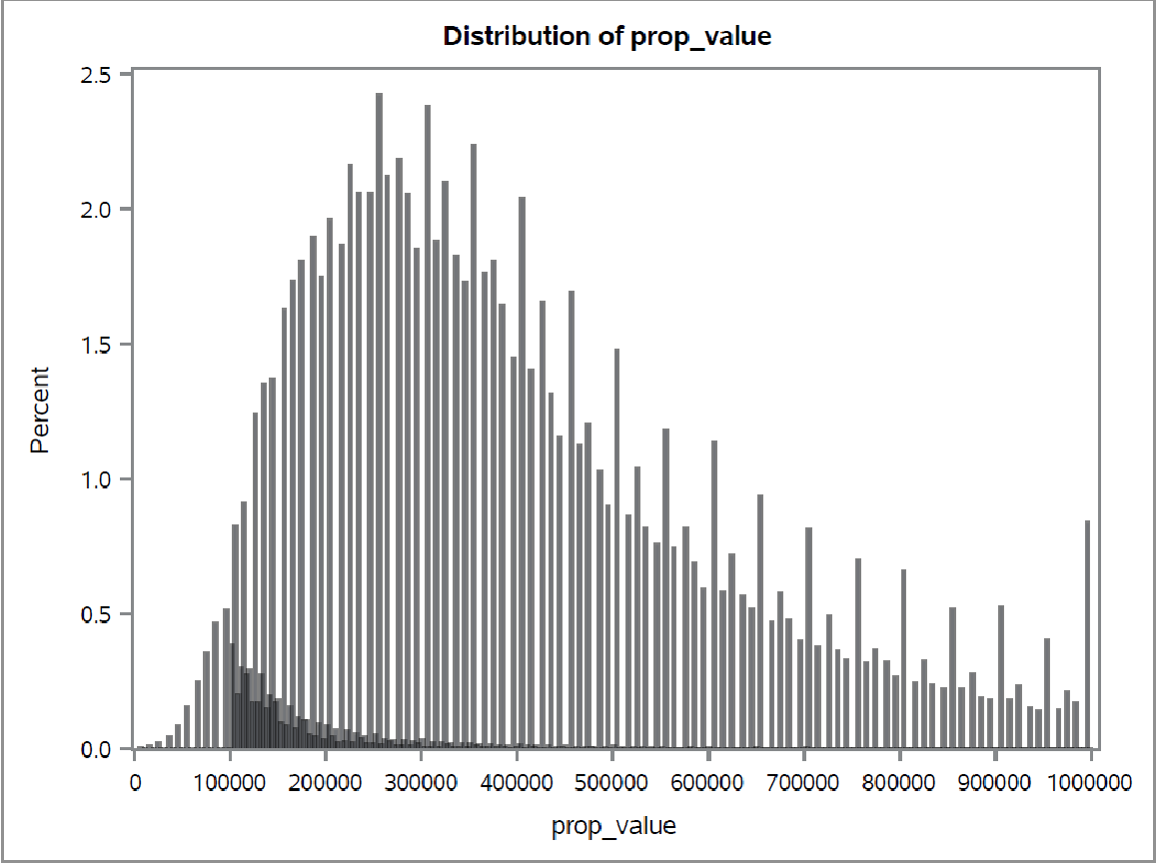
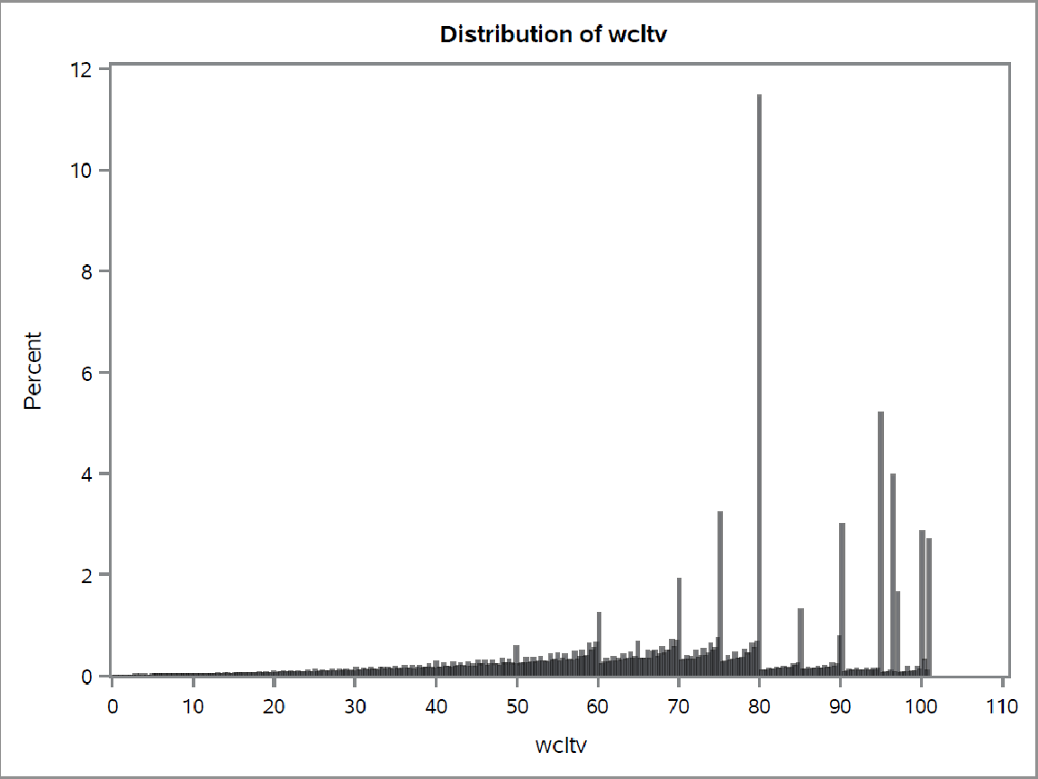
Why Trimming
Exhibit
Univariate Plots of Continuous Variables
While Winsorizing may preserve the data to a fuller extent, preliminary univariate analysis shows it may cause skewed data, and since the dataset still has over 13 million observations, the trimming method is chosen.
Technology Tool Offerings Take Rate³
High Low
~$10,300 ~$12,000
~35 days ~42 days
~6% ~10%
Variance
7 days shorter
4% points lower

Slide 12

Data Visualization
3
Univariate Analysis
Bivariate Analysis
Interactive Dashboard

Slide 13
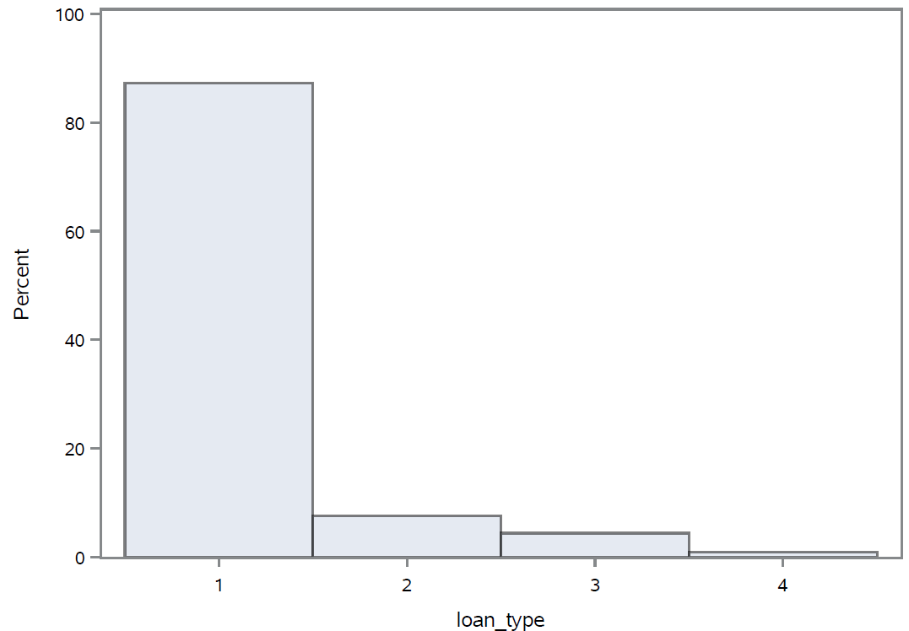
Univariate Analysis - Loan Type
1 – Conventional
2 – FHA
3 – VA
4 – RHS or FSA

Slide 14
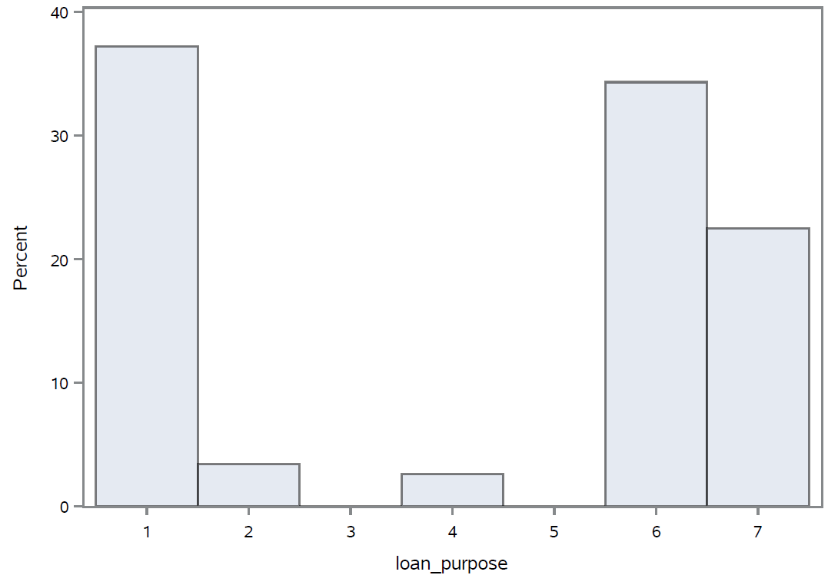
Univariate Analysis - Loan Purpose
1 – Purchase
2 - Improvement
3 – Not Applicable
4 – Other
5 – Not Applicable
6 –Refinancing
7 – Cash-out Refinancing

Slide 15
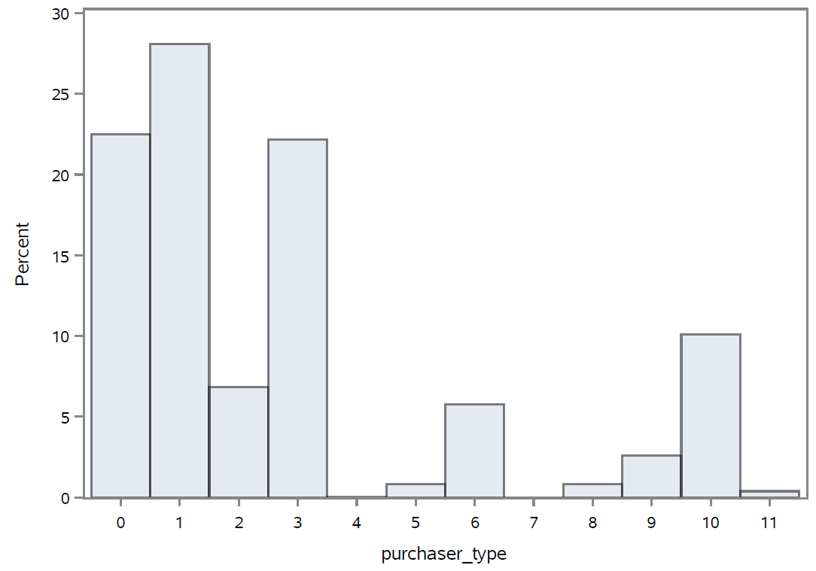
Univariate Analysis - Purchaser Type
0 – Not Applicable
1 – Fannie Mae
2 – Ginnie Mae
3 – Freddie Mac
4 – Farmer Mac
5 – Pvt. securitizer
6 – Banks
7 – Not Applicable
8 – Affiliate Inst
9 – Other
10 – Credit Union
11 – Life Insurance

Slide 16
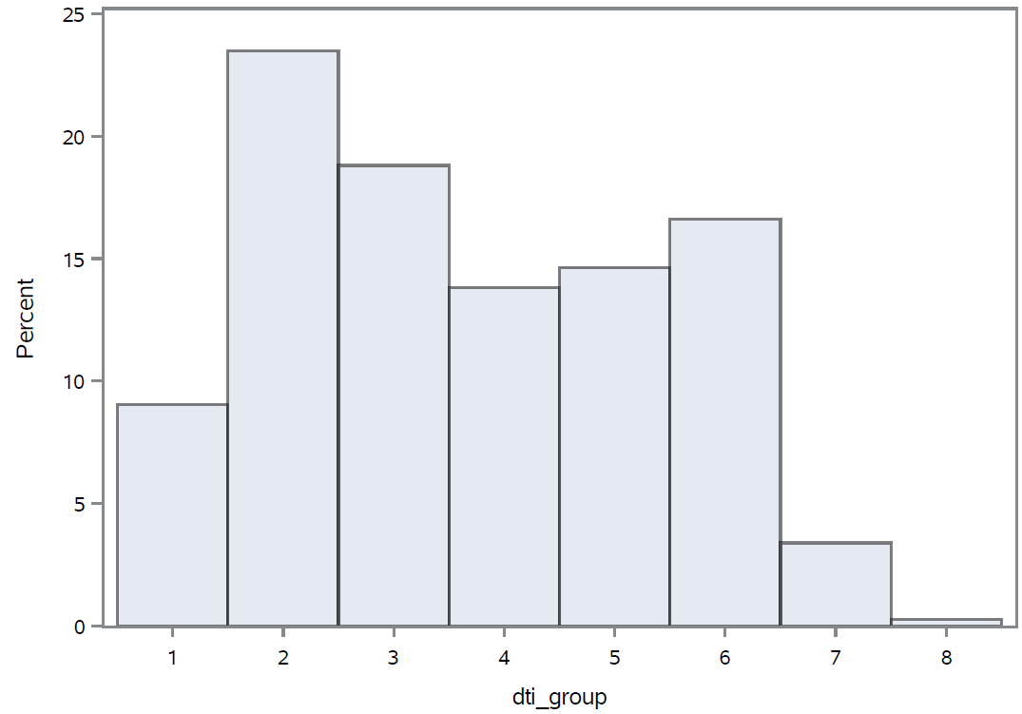
Univariate Analysis - Debt to Income Group
1 – <20%
2 – 20%-30%
3 – 30%-36%
4 – 36%-39%
5 – 40%-43%
6 – 44%-49%
7 – 50%-60%
8 – >60%

Slide 17
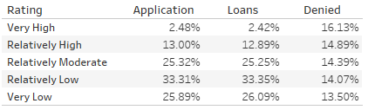
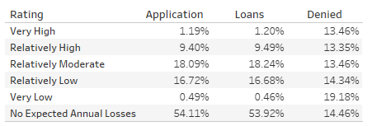
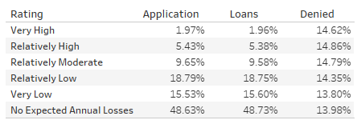
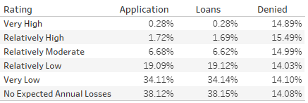
Bivariate Analysis - Application Analysis
Total Risk Rating
Cold Wave Risk Rating
Wildfire Risk Rating
Drought Risk Rating

Slide 18
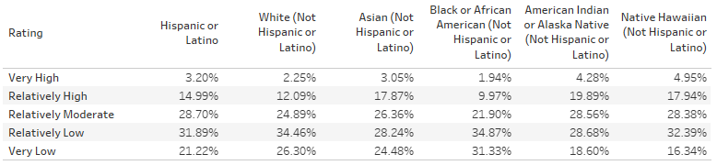
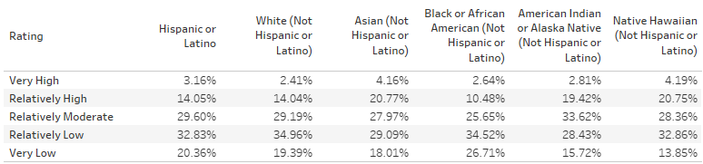
Bivariate Analysis - Race & Ethnicity
Total Risk Rating
Total EAL Risk Rating

Slide 19
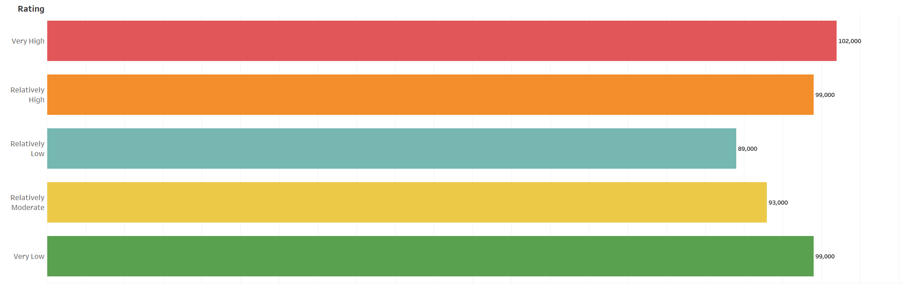
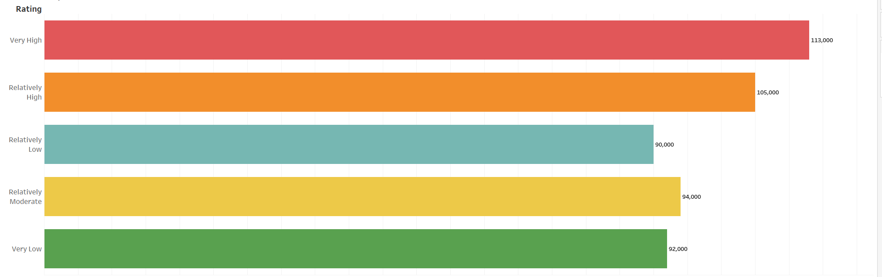
Bivariate Analysis - Median Family Income
Total Risk Rating
Total EAL Risk Rating

Slide 20
Interactive Dashboard
2
Ratings Standards
51
States
18
Hazards
6
Purchaser Type
1831
Counties

Slide 21
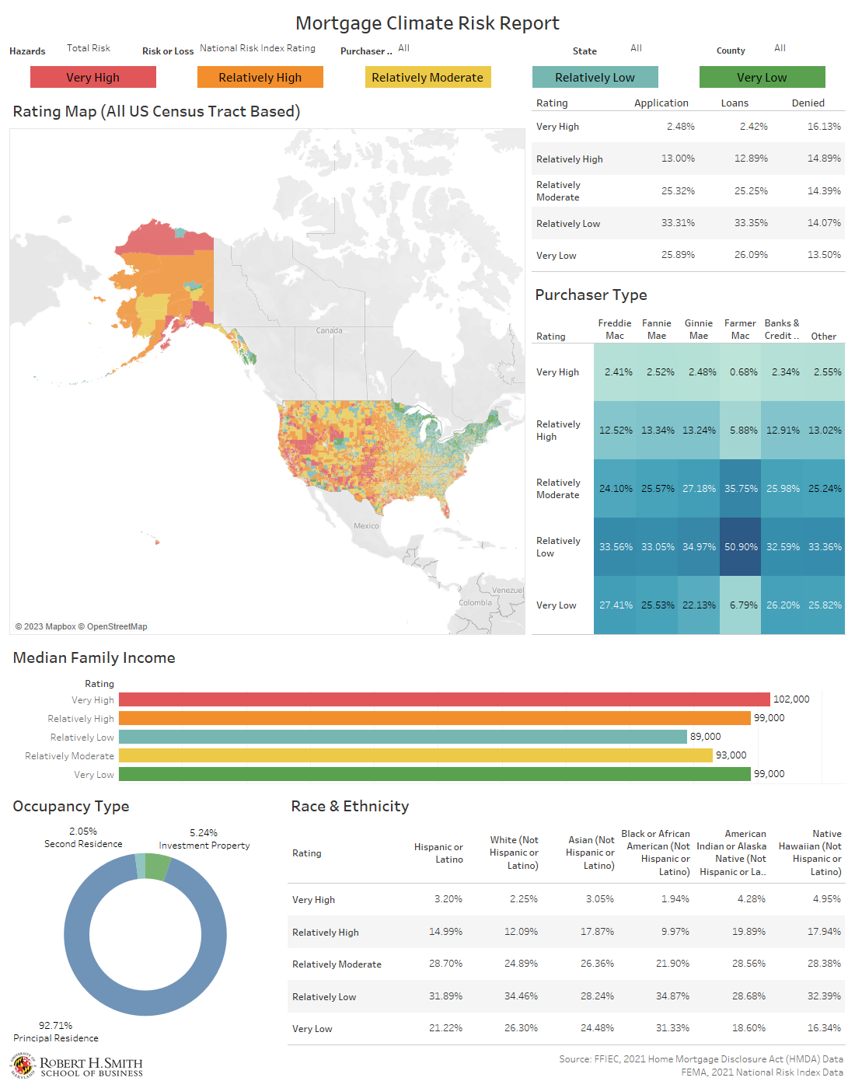
Interactive Dashboard
Dashboard Link

Slide 22
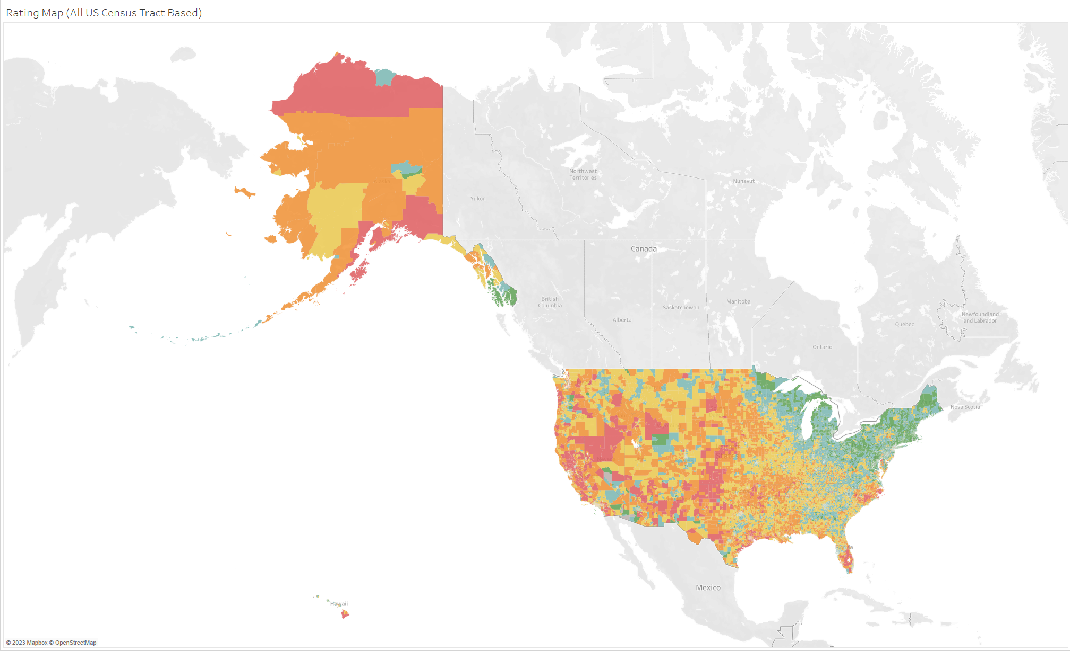
Interactive Dashboard - Total Risk Rating Map

Slide 23
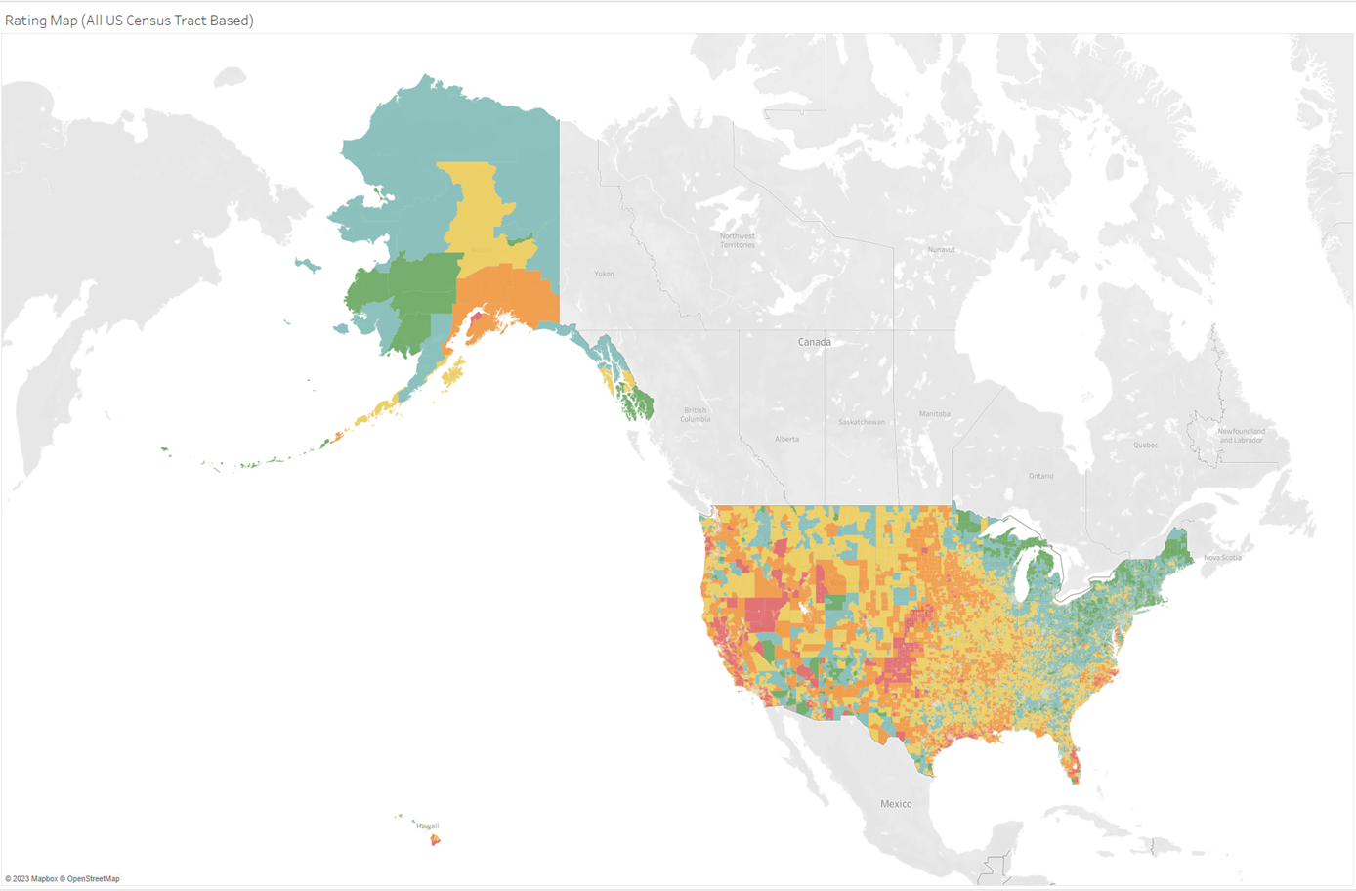
Interactive Dashboard - Total Risk EAL Rating Map

Slide 24
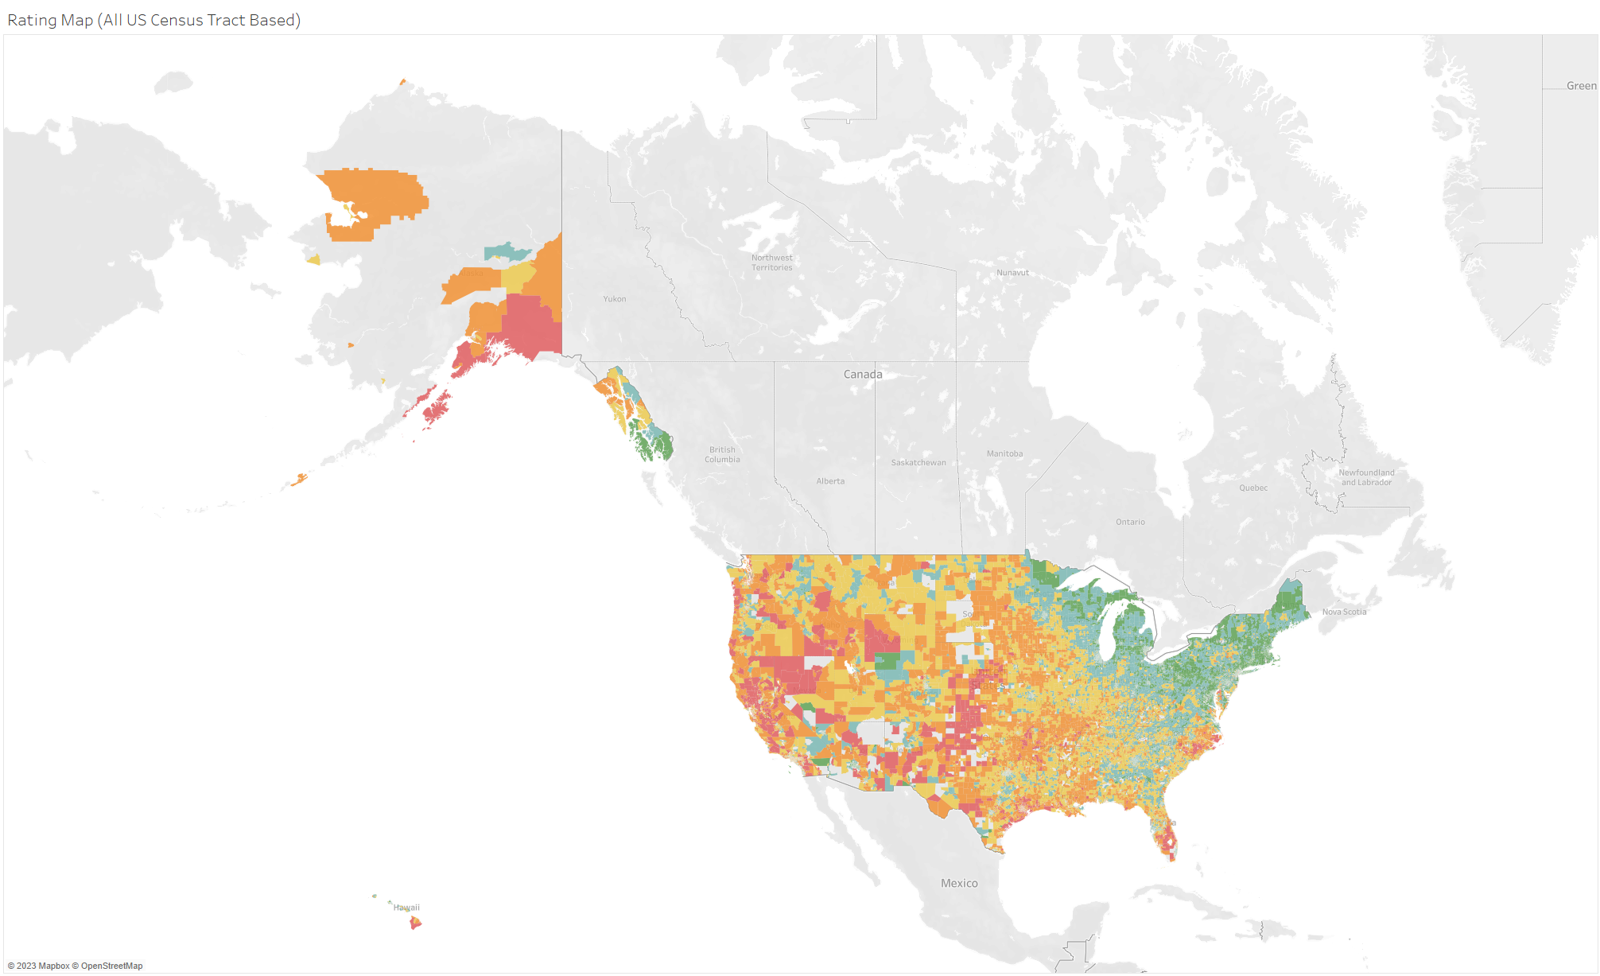
Interactive Dashboard - Total Risk Rating Map ( Freddie Mac)

Slide 25
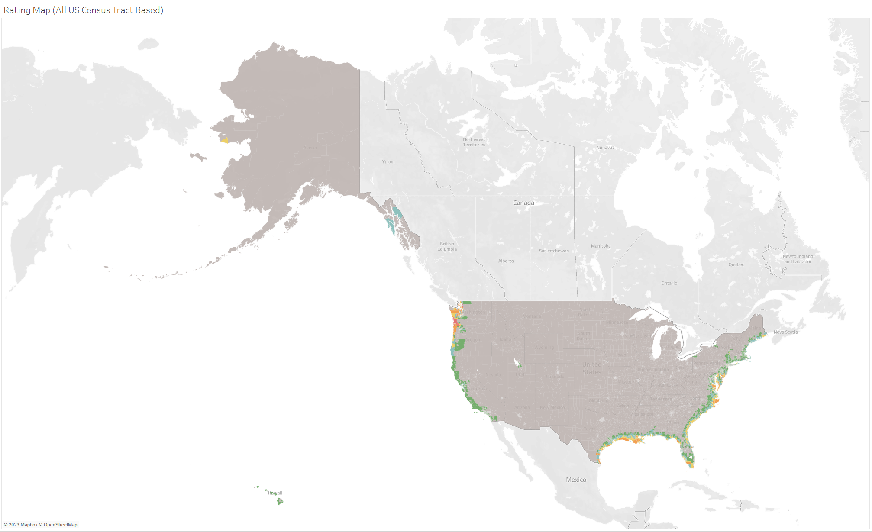
Interactive Dashboard - Coastal Flooding Risk Rating Map

Slide 26
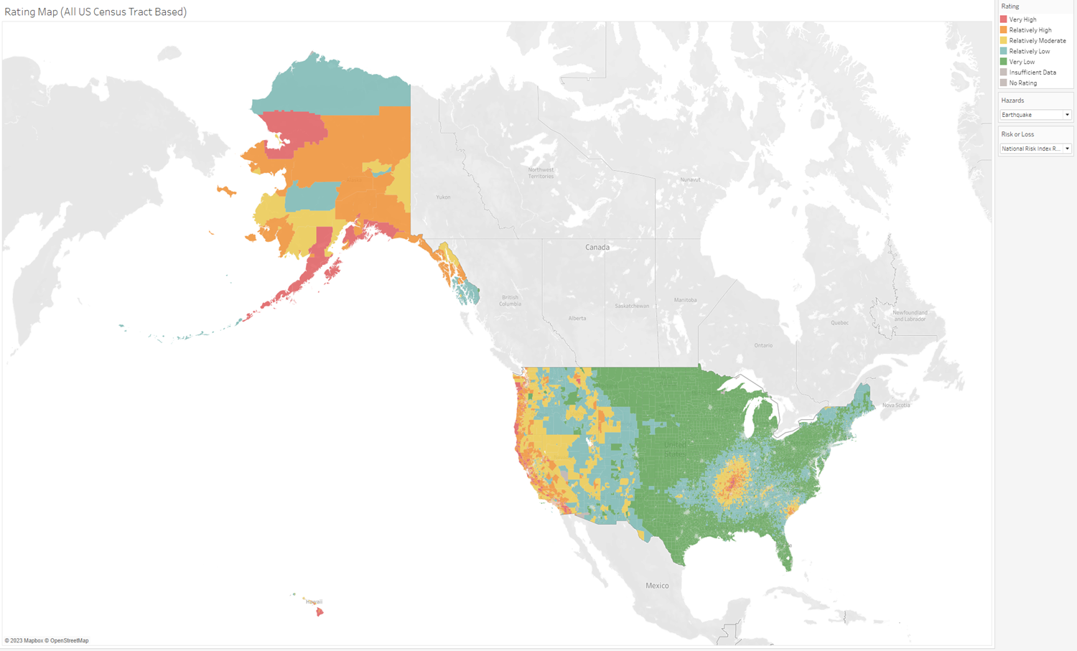
Interactive Dashboard - Earthquake Risk Rating Map

Slide 27
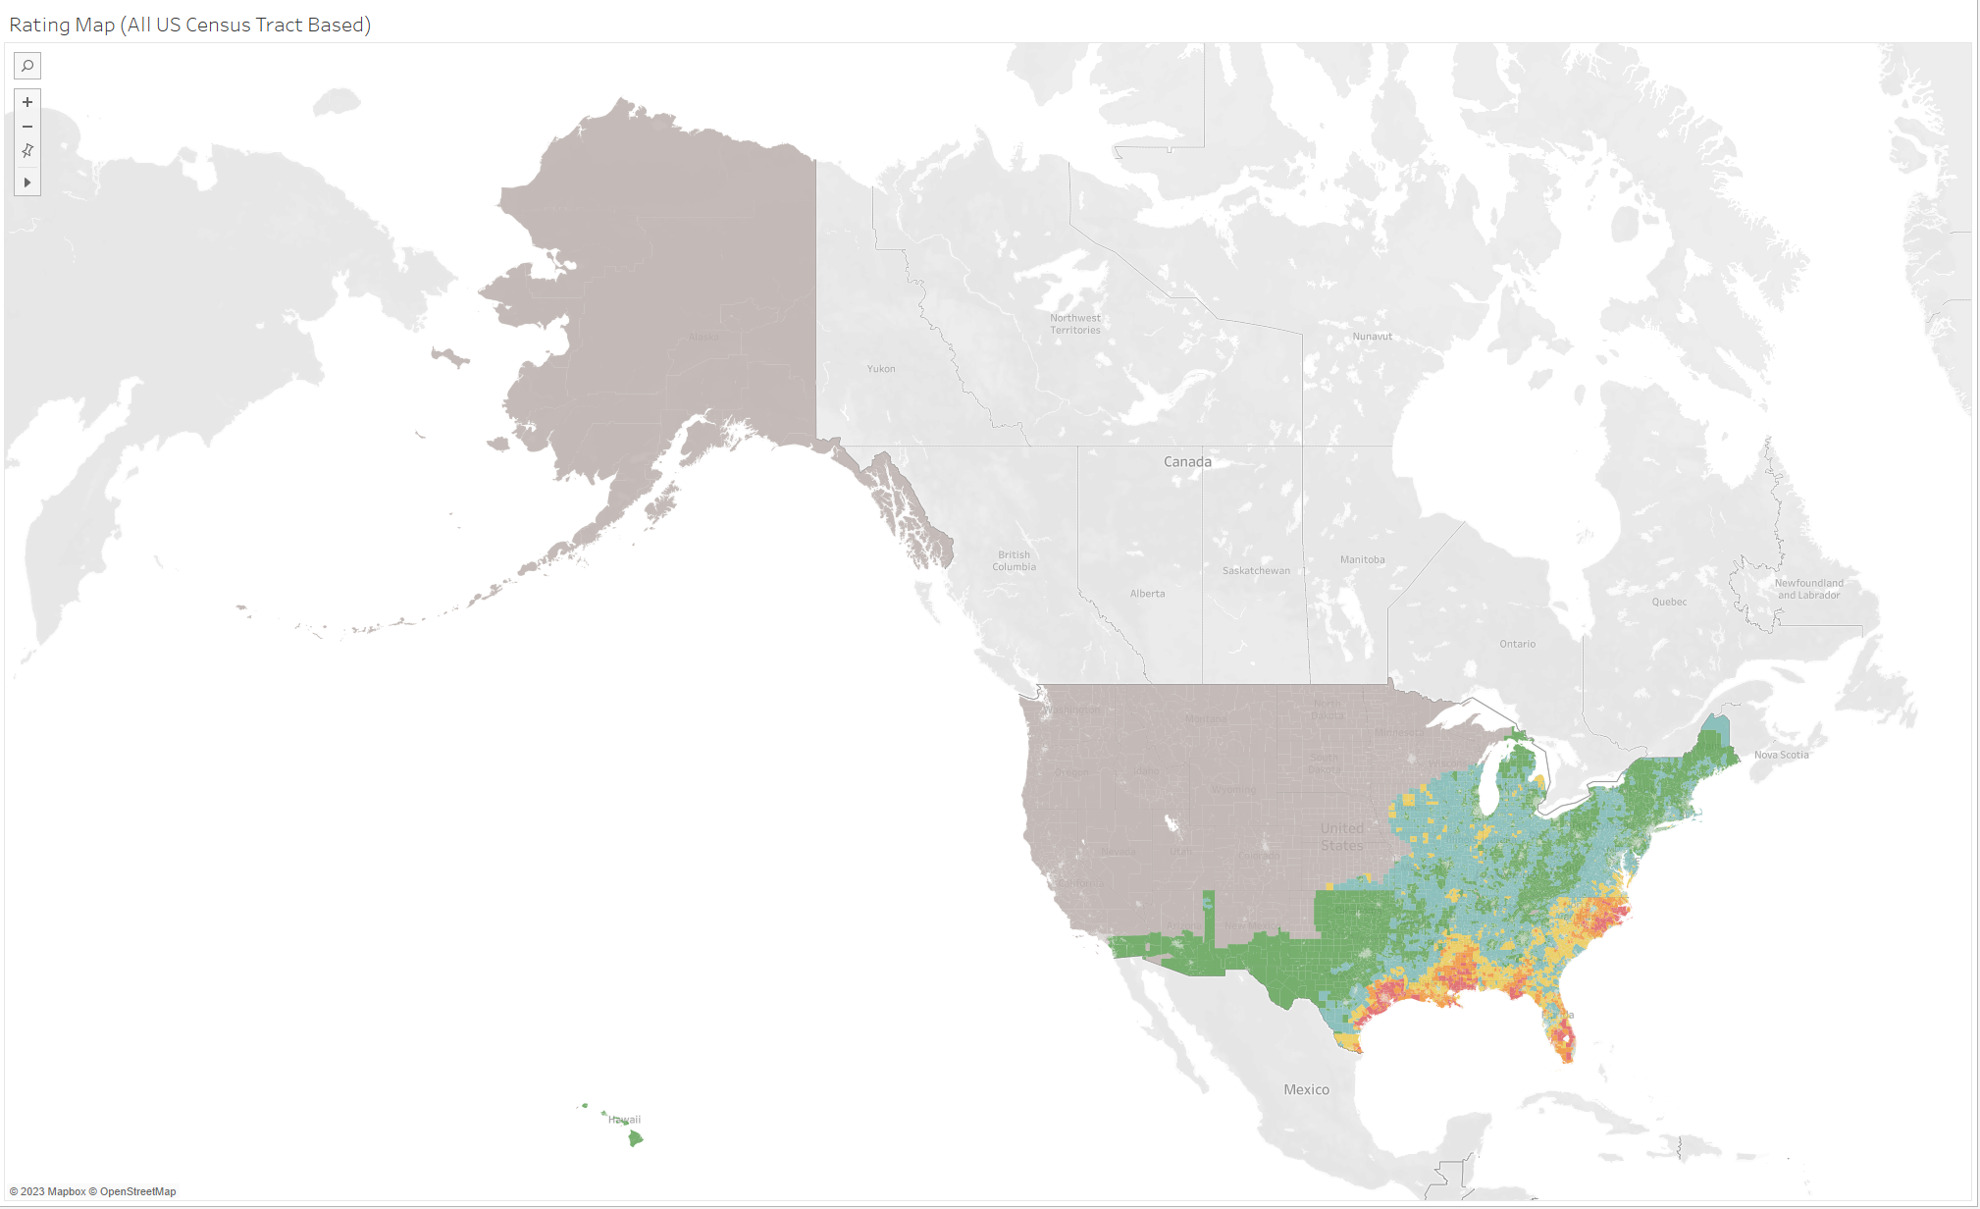
Interactive Dashboard - Hurricane Risk Rating Map

Slide 28
Model Building and Validation
Formalize models that provide feature selection, have predictive power and enable inference
4.1
Target Variables
Features
Candidate Models
2.8
Feature Selection
0.7
1.1
2.9
1.1
0.9
1.0
0.7
1.5
Model Results
0.6
0.8
0.8
0.9
1.0
1.1
1.2
1.3
1.6
2.0
1.8
1.6
Champion Model
Model Inference
Further Refinement

Slide 29
Target Variables
Overall Risk/EAL Rating
Overall Risk/EAL Score (Continuous Numerical Variable, from 0 to 100)
0
100
Relationship between Risk and Expected Annual Loss
Risk
=
Expected Annual Loss * Social Vulnerability
Community Resilience
RR (Risk Rating)
Risk Rating = very high, relatively high
then RR = 1
RR Bisection
Risk Score > = 50% percentile
then RS Bisection = 1
RR Reverse
Risk Rating = very low, relatively low
then RR Reverse = 1
ER (EAL Rating)
EAL Rating = very high, relatively high
then ER = 1
ES Bisection
EAL Score >= 50% percentile
then ES Bisection = 1
ER Reverse
EAL Rating = very low, relatively low
then ER Reverse = 1

Slide 30
Features
Tract-Level | Borrower’s Characteristics | Loan Characteristics | Others
tract population | Age | Loan Amount | Property Value
tract minority population percent | Debt-to-Income Ratio | Loan Term | Total Units
ffiec msa md median family income | Combined Loan-to-Value | Loan Type | Hoepa
tract to msa income percentage | Income | Loan Purpose | Construction Method
tract owner occupied units | Number of Borrowers |  | Occupancy Type
tract one to four family homes | Race |  | Purchaser Type
tract median age of housing unit | Ethnicity

Slide 31
Candidate Models
To fully test the relationship between the features and the target variables, a variety of statistical analysis were conducted
Logistic Regression
Random Forest
Ridge Regression
Naive Bayes Classifier
Lasso Regression
eXtreme Gradient Boosting
Elastic Net
Support Vector Machine
Ordered Logistic
Neural Network
Multinomial Logistic
K Nearest Neighbor

Slide 32
Candidate Models - Feature Selection
Multicollinearity Test
Champion Model
1
1. Correlation Matrix
2.Variance Inflation Factors Analysis
3
Compare the Best Model
select
Champion Model.
38 Features in Total
2
Refinement Required
4
Too many input features at the same time.
Might have multicollinearity problem.
Different Models
generate
Different Important Features.
Select the Best Model in Different Model Categories.

Slide 33
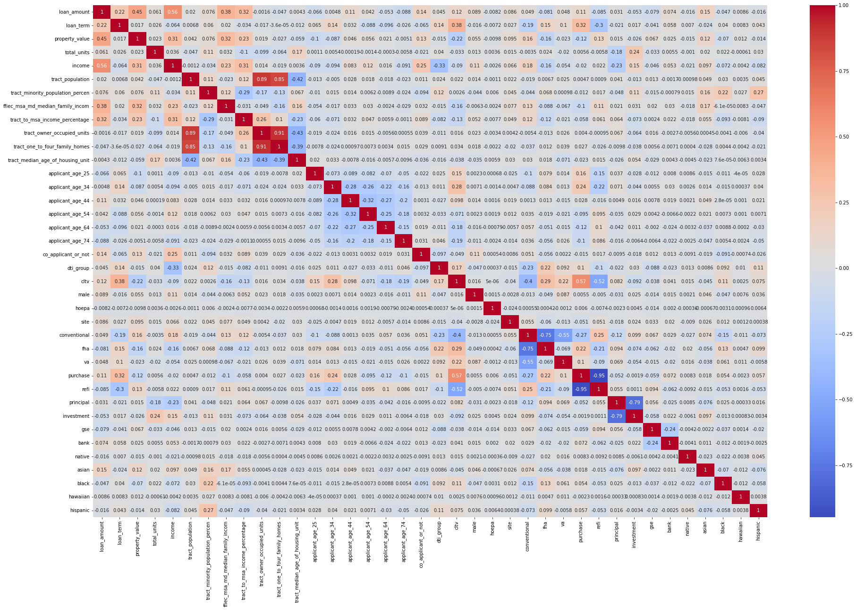
Candidate Models - Feature Selection

Slide 34
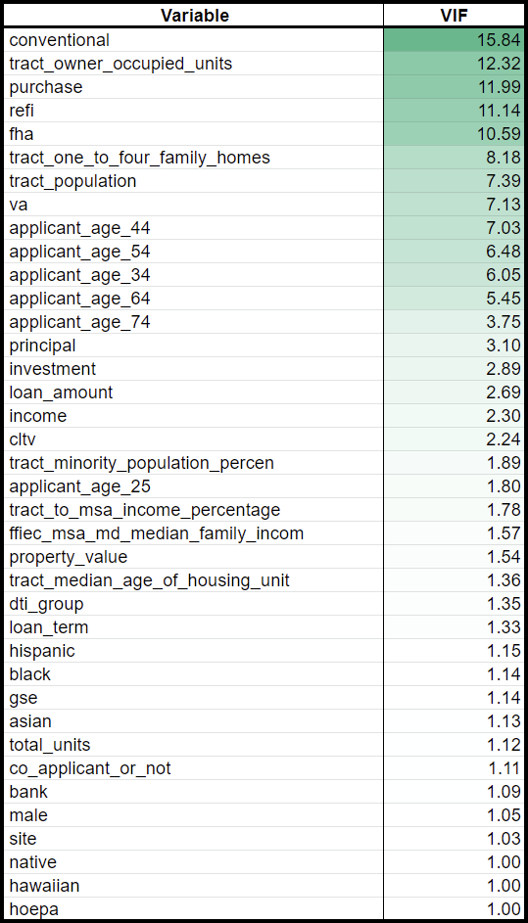
Candidate Models - Feature Selection
Multicollinearity Test (Variance Inflation Factor)

Slide 35
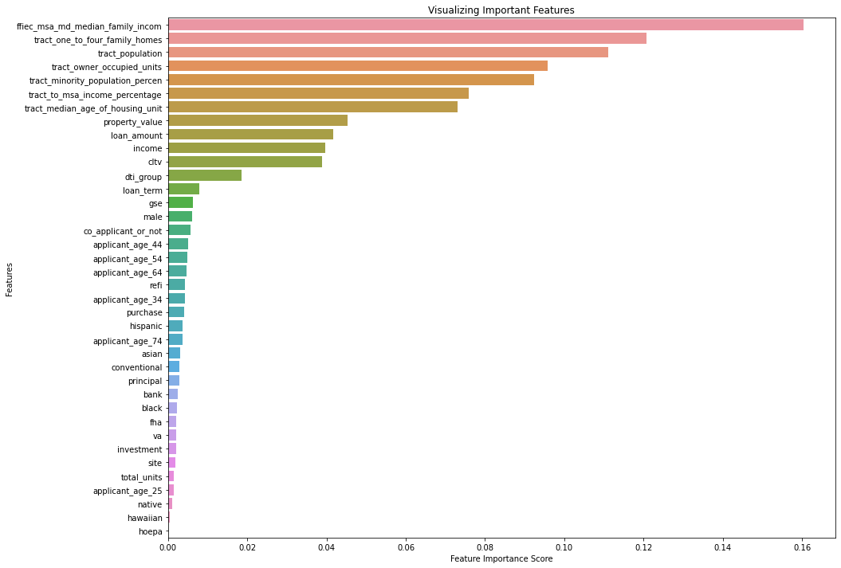
Candidate Models – Feature Selection
Feature Importance Plot
Features: All
Target Variable: ER
ER = 1 when EAL Rating is Relatively High and Very High.
ER = 0 when EAL Ratings are others.

Slide 36
Model Results
Mean Squared Error (MSE): Measures the amount of error in statistic models.
K-S Ratio: Measures the degree of separation between the cumulative distribution functions
of the predicted probabilities for the positive and negative outcomes in the model.
Accuracy Score: Measures the proportion of correct predictions made by the mode out of
all the predictions made.
Recall Score: Measures the proportion of true positives (correctly predicted positive instances)
out of all positive predictions made by the model.
Precision Score: Measures the proportion of true positives out of all actual positive instances.

Slide 37
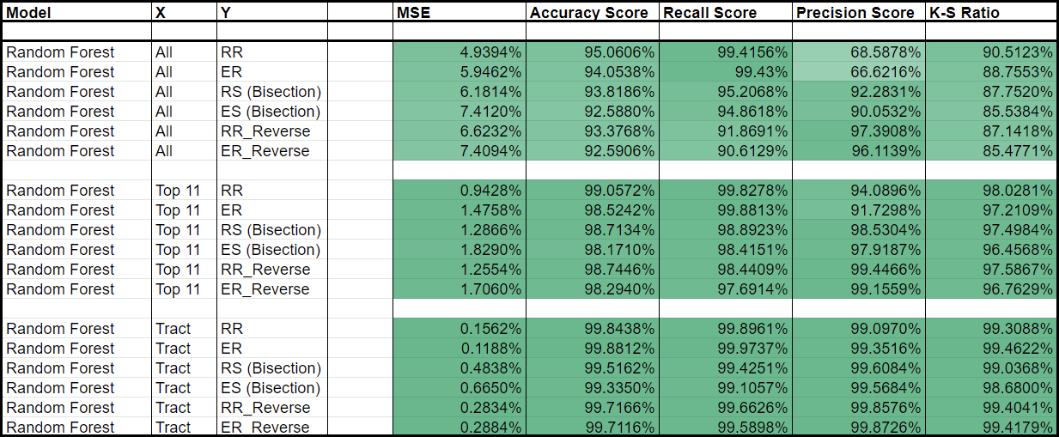
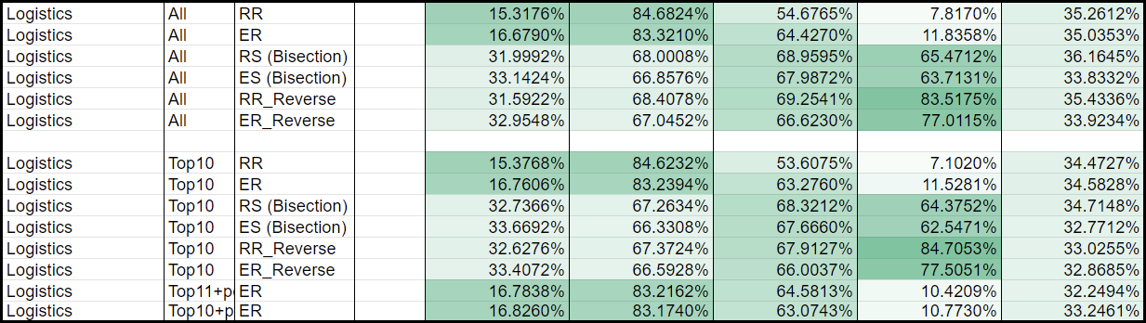
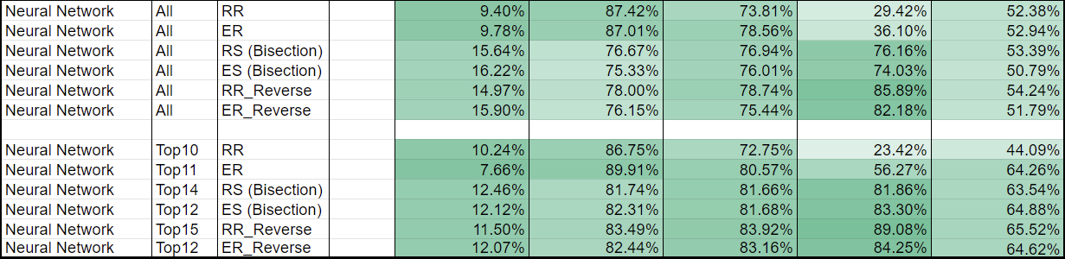
source: Model Results.xlsx

Slide 38
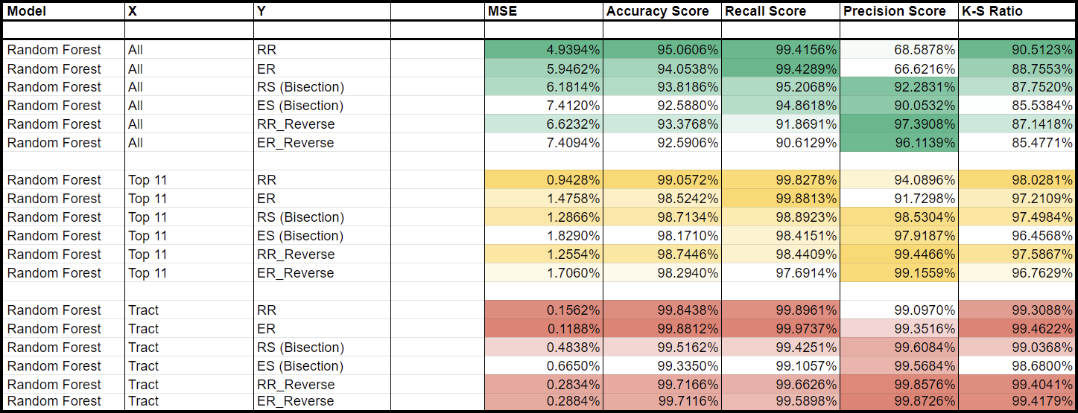
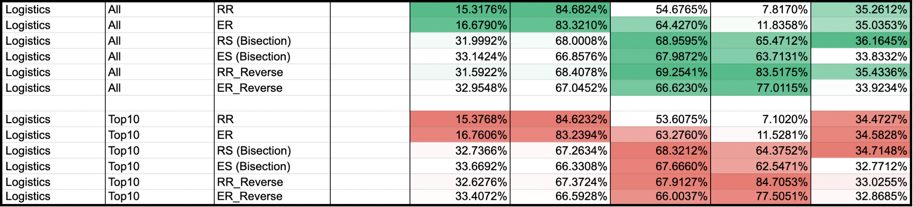
Champion Model
source: Model Results.xlsx

Slide 39
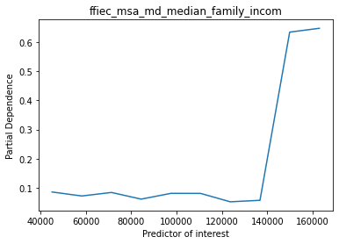
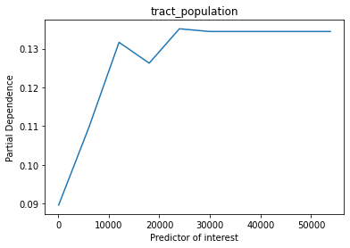
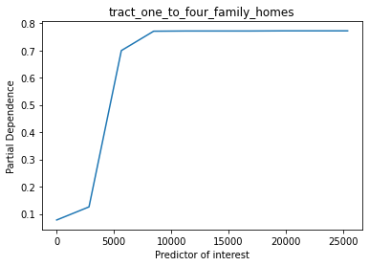
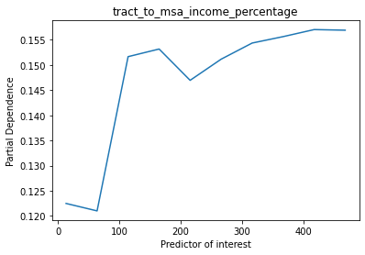
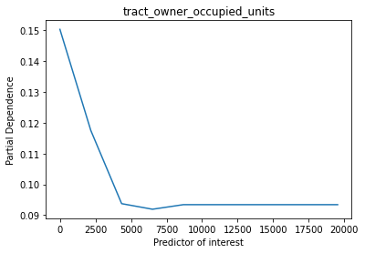
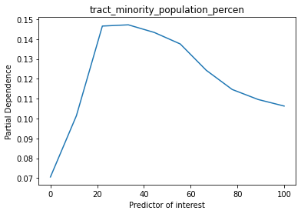
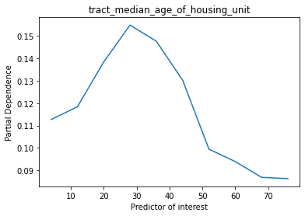
Statistical Inference - Partial Dependence Plot
Positive: ffiec msa md median family income, tract population, tract one to four family homes,
tract to msa income percentage
Negative: tract owner occupied units
Different Trend in Different Bucket: tract minority population percent, tract median age of housing unit

Slide 40
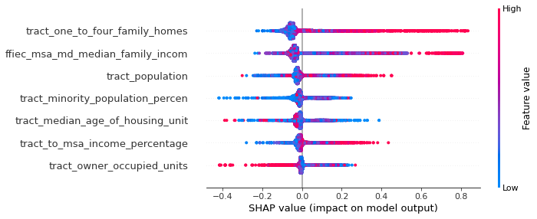
Statistical Inference - Beeswarm Plot
The location of the cluster decides the relationship between features and Target Variable.
If the cluster falls onto the left to the 0, then the feature has the Negative relationship with the target variable.
If the cluster falls onto the Right to the 0, then the feature has the Positive relationship with the target variable.
Feature Importance Rank: The more scattered the points, the more important the variable is.

Slide 41
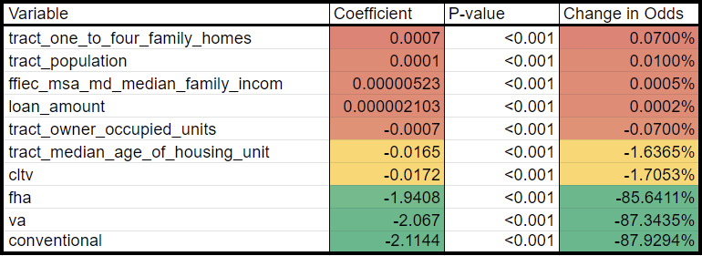
Statistical Inference - Change in Odds
The coefficients of the logistic regression in terms of the change in odds can be interpreted as if the census tract has 1 more unit of 1-4 family home, then the loan is exposed to 0.07% more odds of being in a high loss area.
A second example would be if loan is issued and insured by VA then the odds of a loan in this tract will have a decreased odds of 87.34%.

Slide 42
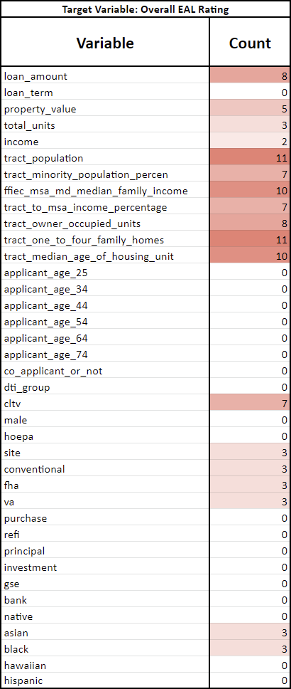
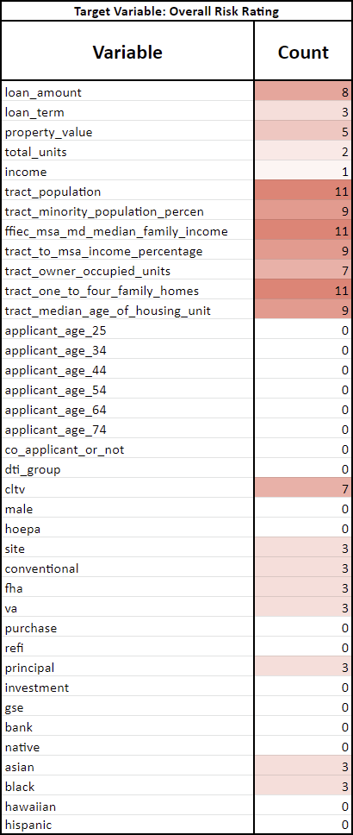
Further Refinement
source: Model Results.xlsx

Slide 43
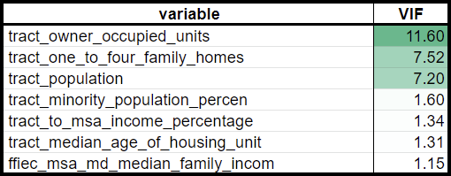
Further Refinement

Slide 44
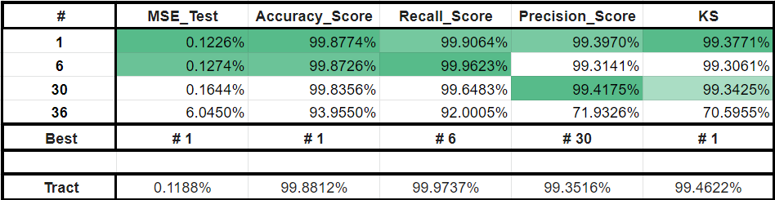
Further Refinement - 3-Factor Model
Sharpley value of tract_own_occupied_units ≈ 0
Rank | Variable 1 | Variable 2 | Variable 3
# 1 | tract population | tract to msa income percentage | ffiec msa md median family income
# 6 | tract one to four family homes | tract owner occupied units | tract minority population percent
# 30 | ffiec msa md median family income | tract median age of housing unit | tract minority population percent
# 36 | cltv | tract one to four family homes | ffiec msa md median family income

Slide 45
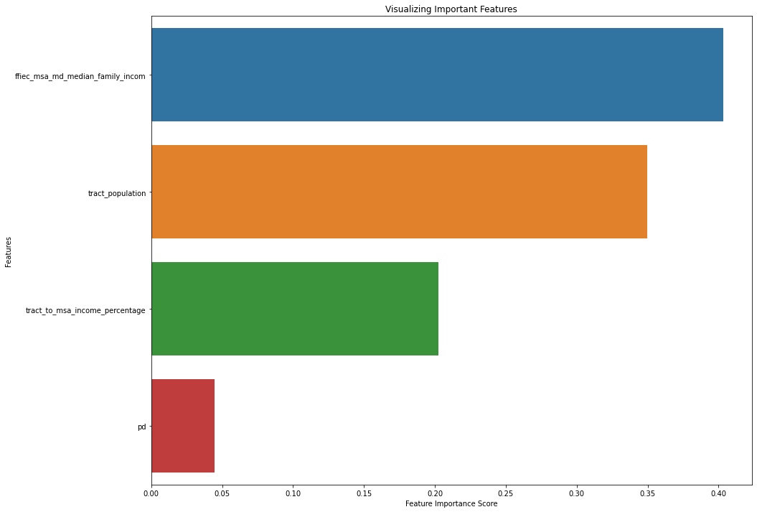
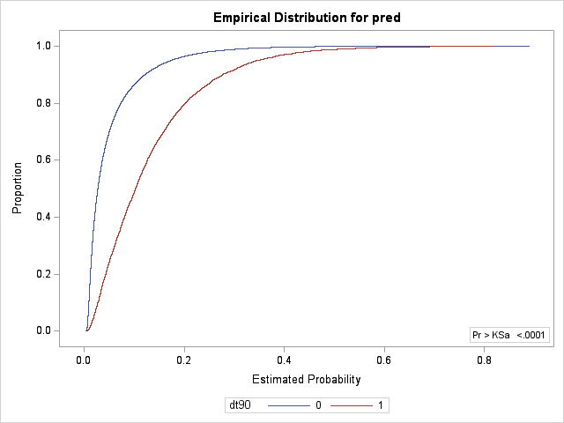
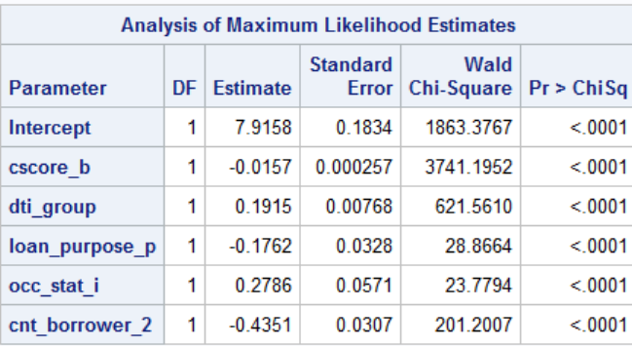
Further Refinement - Probability of Default
If individual borrower’s attribute does not have a significant explanatory power to the loss rating, an aggregate variable might boost the predictability.
An aggregate variable would be the probability of default calculated by the borrower’s attribute. By using a GSE dataset from 2017, we have obtained the logit coefficients of some of the main borrower’s attributes, and the default model has achieved a K-S statistics of 45.74%. With the obtained coefficients, we applied the logit model in our HMDA data, and produced a “probability of default” variable for each loan.
The variable is then used in the Random Forest model with the top 3 tract-only variables. However, the borrower’s importance remains a low importance in predictability. Which led to a worse result than the 3-factor model, and the model is discarded.
Exhibit
Default Probability Prediction
Table
Default Coefficient
Mortgage Climate Risk Report
Mar 2023 | ‹#›

Slide 46
Hazard Modeling
Testing if any variable has any significance to specific hazards
4.2
Hazard Selection
Data Cleaning
2.8
0.7
1.1
2.9
0.9
1.0
0.7
Modeling Results
1.5
1.1
0.6
0.8
0.8
0.9
1.0
1.1
1.2
1.3
1.6
2.0
1.8
1.6

Slide 47
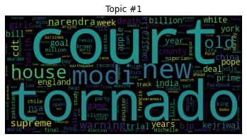


Hazard Selection
Based on the Natural Language Processing and topic modelling on over 5,000 random tweets, the more relevant topics are shown in the graphs to the left.
People express their concern and direct their conversation towards Tornado and Fire.
~$1,700 less
7 days shorter
4% points lower

Slide 48

Hazard Selection
Variable | N | Median | Sum
AVLN EALT | 1867855 | 40393.56 | 587422418287
CFLD EALT | 5925195 | 0.7968158 | 325466369368
DRGT EALT | 13257046 | 7.3198588 | 576127341773
ERQK EALT | 13257046 | 9716.64 | 1.8272436E12
HRCN EALT | 9562853 | 1860.72 | 1.1313771E12
TRND EALT | 13257046 | 37347.51 | 1.1755214E12
WFIR EALT | 13177171 | 1.1173335 | 582318334315
Sum of Loss
The 6 hazards with the highest sum of expected loss are Earthquake, Hurricane, River Flooding, Tornado, Avalanche and Drought.
Median of Loss
The 6 hazards with the highest median of expected loss are Avalanche, Tornado, Volcano, River Flooding, Earthquake and Strong Wind.
Selection
The number of observations for Avalanche and Volcano are relatively low, the two hazards are dropped in our selection

Slide 49

Hazard Modelling - Data Cleaning
To avoid skewed dataset, missing data were dropped.
Very High | Very Low
Relatively High | No Expected Annual Loss
Relatively Moderate | Not Applicable
Relatively Low | Insufficient Data
Very High
Relatively High
Relatively Moderate
Relatively Low
Very Low

Slide 50

Hazard Modelling - Results

Slide 51

Project Overview
This project aims to analyze the relationship between mortgage attributes to climate risks
Thank You For Listening
Mar 2023

Slide 52
Appendix
5
2.8
0.7
1.1
2.9
1.1
0.9
1.0
0.7
0.5
1.5
0.6
0.8
0.8
0.9
1.0
1.2
1.3
1.6
2.0
1.8
1.6

Slide 53
Model Refining
Confusion Matrix:
 | Predicted Positive | Predicted Negative
Actual Positive | True Positive | False Negative
Actual Negative | False Positive | True Negative

Slide 54

Naïve Bayes
Definition:
Naïve Bayes is a simple learning algorithm that utilizes Bayes’ rule together with a strong assumption that the attributes are conditionally independent given the class. While this independence assumption is often violated in practice, naïve Bayes nonetheless often delivers competitive classification accuracy. Coupled with its computational efficiency and many other desirable features, this leads to naïve Bayes being widely applied in practice.
Assumption:

Slide 55

Naïve Bayes
Principle of classification:

Slide 56


Naïve Bayes
Principle of classification:

Slide 57

Model Results of Naïve Bayes

Slide 58


Model Results of Random Combination of Random Forest
When selecting 2 variables:

Slide 59


Model Results of Random Combination of Random Forest
When selecting 3 variables:

Slide 60


Model Results of Random Combination of Random Forest
When selecting 8 variables:

Slide 61


Model Results of Random Combination of Random Forest
When selecting 9 variables:

Slide 62
Ridge, Lasso, Elastic Net
Overview
Used for regularization and feature selection
Ridge: deals with multicollinearity, shrinks regression coefficient towards zero
Lasso: performs feature selection, causes regression coefficient to be exact zero
ElasticNet: combines ridge and lasso, improve the regularization of statistical model
Why use Ridge, Lasso, ElasticNet?
Overfitting concern
Feature selection
Improve performance
Interpretability

Slide 63

Ridge Regression
Definition:
Ridge regression is a model tuning method that is used to analyse any data that suffers from multicollinearity. This method performs L2 regularization. When the issue of multicollinearity occurs, least-squares are unbiased, and variances are large, this results in predicted values being far away from the actual values.
The cost function for ridge regression:
Lambda is the penalty term. λ given here is denoted by an alpha parameter in the ridge function. So, by changing the values of alpha, we are controlling the penalty term. The higher the values of alpha, the bigger is the penalty and therefore the magnitude of coefficients is reduced.
Source: https://www.mygreatlearning.com/blog/what-is-ridge-regression/

Slide 64

Lasso Regression
Definition:
Lasso regression is a regularization technique. It is used over regression methods for a more accurate prediction. This model uses shrinkage. Shrinkage is where data values are shrunk towards a central point as the mean. The lasso procedure encourages simple, sparse models (i.e. models with fewer parameters). This particular type of regression is well-suited for models showing high levels of multicollinearity or when you want to automate certain parts of model selection, like variable selection/parameter elimination.
The cost function for lasso regression:
Lasso regression performs L1 regularization, which adds a penalty equal to the absolute value of the magnitude of coefficients. This type of regularization can result in sparse models with few coefficients; Some coefficients can become zero and eliminated from the model. Larger penalties result in coefficient values closer to zero, which is the ideal for producing simpler models.
Source: https://www.statisticshowto.com/lasso-regression/

Slide 65

Elastic Net Regression
Definition:
Elastic net linear regression uses the penalties from both the lasso and ridge techniques to regularize regression models. The technique combines both the lasso and ridge regression methods by learning from their shortcomings to improve the regularization of statistical models.
The elastic net technique solves this regularization problem. For an alpha strictly between 0 and 1, and a nonnegative lambda, elastic net solves the problem:
where:
Source: https://www.mathworks.com/help/stats/lasso-and-elastic-net.html
https://corporatefinanceinstitute.com/resources/data-science/elastic-net/

Slide 66

Ridge Regression: alpha = 1
Data Set: Train: 500,000
Test: 500,000
X: All variables after standardization
Y: EAL Rating / Risk Rating
Top Variables: Variables after shrinkage
Selection Method: Coefficient and p-value

Slide 67


Lasso Regression: alpha = 0.01
Elastic Net Regression: alpha = 0.1, l1 ratio = 0.1

Slide 68

KNN (K-Nearest Neighbors Algorithm)
Overview
On-parametric, supervised learning classifier
Make classifications or predictions about the grouping of an individual data point
Why KNN?
Simplicity
Versatility
Robustness
Interpretability
Effectiveness

Slide 69
KNN (K-Nearest Neighbors Algorithm)
Definition:
The k-nearest neighbors algorithm, also known as KNN or k-NN, is a non-parametric, supervised learning classifier, which uses proximity to make classifications or predictions about the grouping of an individual data point. While it can be used for either regression or classification problems, it is typically used as a classification algorithm, working off the assumption that similar points can be found near one another.
For classification problems, a class label is assigned on the basis of a majority vote—i.e. the label that is most frequently represented around a given data point is used. While this is technically considered “plurality voting”, the term, “majority vote” is more commonly used in literature. The distinction between these terminologies is that “majority voting” technically requires a majority of greater than 50%, which primarily works when there are only two categories.

Slide 70


KNN (K-Nearest Neighbors Algorithm)
Defining k:
The k value in the k-NN algorithm defines how many neighbors will be checked to determine the classification of a specific query point. Due to the different variables we use, the optimal k varys from 18 to 27. To have a same stander, we use k=25 as the default value for all knn models.
Determine distance metrics:
Euclidean distance (p=2): This is the most commonly used distance measure, and it is limited to real-valued vectors. Using the below formula, it measures a straight line between the query point and the other point being measured.

Slide 71

KNN (K-Nearest Neighbors Algorithm)
Data Set: Train: 500,000
Test: 500,000
X: All variables after standardization
Y: Eal Rating or Risk Rating
Top Variables: Tract Only

Slide 72


Neural Network Classification Model
Using All Variables
Overfitting
Noisy Features
Reasons for
weak results
Multicollinearity
Curse of dimensionality
Using Feature Selection
All Tract variables
CLTV
Selected
Features
Source: Freddie Mac
Race: Asian & Black
Property values
Loan Amount
Loan Amount

Slide 73


Neural Network Classification Model
Output with all features
MSE
Accuracy
Recall
Precision
K-S Ratio
Output with selected features
MSE
Accuracy
Recall
Precision
K-S Ratio
Source: Freddie Mac

Slide 74

XGBoost (eXtreme Gradient Boosting)
Overview
XGBoost is a open-source machine learning library that provides implementation of gradient boosting algorithms
Used for classification, regression and ranking problems
Principle
Creating a series of decision trees which are trained sequentially
Each subsequent tree tries to correct the errors of the previous trees
Combining weak models to generate a collectively strong model
Why XGBoost?
Performance
Flexibility
Feature Importance
Regularization
Handling Missing Values
Built-in CV
Interpretability

Slide 75

XGBoost Output

Slide 76

Support Vector Machines (SVM)
Strengths:
High dimensional data
Non-linear relationship
Weakness:
Very computationally consuming
Not interpretive

Slide 77
Support Vector Machines (SVM)
Support Vector Machines (SVMs) are a type of machine learning model that is widely used for classification and regression tasks. SVMs work by identifying a hyperplane in a high-dimensional space that best separates the data into different classes. The hyperplane is chosen to maximize the margin, which is the distance between the hyperplane and the closest data points from each class.
SVMs are particularly useful when dealing with high-dimensional data and when the data is not linearly separable. They can also handle noisy data and outliers well. SVMs have been successfully used in a variety of applications, including text classification, image classification, and bioinformatics.
One of the strengths of SVMs is their ability to handle complex decision boundaries. This makes them particularly useful when dealing with non-linearly separable data. SVMs also have a strong theoretical foundation, which makes them well-suited for problems where interpretability is important.

Slide 78

Support Vector Machines (SVM)
Data Set: Train: 500,000
Test: 500,000
X: All variables after standardization
Y: Eal Rating or Risk Rating
Kernel Function: RBF (Non-linear)
Top Variables: Tract Only
Selection Method: Forward Stepwise

Slide 79

Borrower Characteristics versus ER / RR
Objective: Explore relation between only borrower features and Risk rating / EAL rating.
Method: Exclude tract features from independent variables to highlight the importance of borrower features.
Target Variable: RR/ER
Independent Variables: All variables at first except tract ones
Train Set Size: 500,000
Test Set Size: 500,000
Model: Random Forest. Use grid search to adjust parameters. Set f1 score as standard

Slide 80

Individual loan features versus Tract Features
Objective: Individual loan features - Tract features
Target Variable: Each Tract Feature
Independent Variables: All variables except seven tract-level ones
Model: Random Forest

Slide 81

Model Inference
Objective: Explain how champion model made classification.
Target Variable: ER
Independent Variables: Tract variables.
Method: Set 5 quantiles as the representative values of each independent variable. Create cartesian product and make predictions. Count the number of data with a dependent variable of 1 at each level.
Model: Random Forest.

Slide 82



Model Inference

Slide 83



Model Inference

Slide 84

Parallel Coordinate Chart of Tract Variables
Greenline: RR = 1, Purple Line: RR = 0

Slide 85

Logistics
Definition:
In statistics, the logistic model is a statistical model that models the probability of an event taking place by having the log-odds for the event be a linear combination of one or more independent variables. In regression analysis, logistic regression (or logit regression) is estimating the parameters of a logistic model (the coefficients in the linear combination). Formally, in binary logistic regression there is a single binary dependent variable, coded by an indicator variable, where the two values are labeled "0" and "1", while the independent variables can each be a binary variable (two classes, coded by an indicator variable) or a continuous variable (any real value). The corresponding probability of the value labeled "1" can vary between 0 (certainly the value "0") and 1 (certainly the value "1"), hence the labeling; the function that converts log-odds to probability is the logistic function, hence the name.
Model:

Slide 86

Logistics Model Results

Slide 87
Logistics ER High
 | All Variables | Coefficient | P-value
1st | tract one to four family homes | 0.6472 | 0.00
2nd | tract owner occupied units | -0.4768 | 0.00
3rd | tract population | 0.3472 | 0.00
4th | loan amount | 0.2057 | 0.00
5th | conventional | -0.1545 | 0.00
6th | cltv | -0.1277 | 0.00
7th | fha | -0.1089 | 0.00
8th | va | -0.1034 | 0.00
9th | ffiec msa md median family incom | 0.1023 | 0.00
10th | tract median age of housing unit | -0.0613 | 0.00
11th | tract to msa income percentage | 0.0594 | 0.00
12th | site | -0.0549 | 0.00
13th | total units | -0.0474 | 0.00
… | … | … | …
Top 10 Variables | Coefficient | P-value
tract one to four family homes | 0.6033 | 0.00
tract owner occupied units | -0.4299 | 0.00
tract population | 0.3437 | 0.00
loan amount | 0.2214 | 0.00
conventional | -0.1592 | 0.00
cltv | -0.1220 | 0.00
fha | -0.1165 | 0.00
va | -0.1091 | 0.00
ffiec msa md median family incom | 0.0915 | 0.00
tract median age of housing unit | -0.0789 | 0.00

Slide 88
Logistics ER Low
 | All Variables | Coefficient | P-value
1st | tract one to four family homes | -0.7328 | 0.00
2nd | tract population | -0.6241 | 0.00
3rd | tract owner occupied units | 0.5593 | 0.00
4th | loan amount | -0.4348 | 0.00
5th | conventional | 0.3537 | 0.00
6th | cltv | 0.2582 | 0.00
7th | fha | 0.2424 | 0.00
8th | tract median age of housing unit | 0.2394 | 0.00
9th | va | 0.2147 | 0.00
10th | ffiec msa md median family incom | 0.1623 | 0.00
11th | site | 0.0981 | 0.00
12th | total units | 0.0966 | 0.00
13th | income | 0.0870 | 0.00
… | … | … | …
Top 10 Variables | Coefficient | P-value
tract one to four family homes | -0.7675 | 0.00
tract population | -0.6354 | 0.00
tract owner occupied units | 0.6239 | 0.00
loan amount | -0.3852 | 0.00
conventional | 0.3620 | 0.00
tract median age of housing unit | 0.2572 | 0.00
fha | 0.2562 | 0.00
cltv | 0.2322 | 0.00
va | 0.2185 | 0.00
ffiec msa md median family incom | 0.1350 | 0.00

Slide 89
Logistics ER Bisection
 | All Variables | Coefficient | P-value
1st | tract one to four family homes | 0.6815 | 0.00
2nd | tract population | 0.6166 | 0.00
3rd | tract owner occupied units | -0.5292 | 0.00
4th | loan amount | 0.4342 | 0.00
5th | conventional | -0.3609 | 0.00
6th | tract median age of housing unit | -0.2840 | 0.00
7th | cltv | -0.2593 | 0.00
8th | fha | -0.2486 | 0.00
9th | va | -0.2175 | 0.00
10th | ffiec msa md median family incom | -0.1997 | 0.00
11th | total units | -0.0983 | 0.00
12th | site | -0.0957 | 0.00
13th | income | -0.0889 | 0.00
… | … | … | …
Top 10 Variables | Coefficient | P-value
tract one to four family homes | 0.7341 | 0.00
tract population | 0.6305 | 0.00
tract owner occupied units | -0.6162 | 0.00
loan amount | 0.3733 | 0.00
conventional | -0.3698 | 0.00
tract median age of housing unit | -0.2986 | 0.00
fha | -0.2643 | 0.00
cltv | -0.2266 | 0.00
va | -0.2222 | 0.00
ffiec msa md median family incom | -0.1660 | 0.00

